Slide 1
Accounting Principles, 7th Edition
Weygandt • Kieso • Kimmel
Chapter 19
Financial Statement Analysis
Prepared by Naomi Karolinski
Monroe Community College
and
Marianne Bradford
Bryant College
John Wiley & Sons, Inc. © 2005

Slide 2
CHAPTER 19 FINANCIAL STATEMENT ANALYSIS
After studying this chapter, you should be able to:
1 Discuss the need for comparative analysis.
2 Identify the tools of financial statement analysis.
3 Explain and apply horizontal analysis.
4 Describe and apply vertical analysis.

Slide 3
CHAPTER 19 FINANCIAL STATEMENT ANALYSIS
After studying this chapter, you should be able to:
5 Identify and compute ratios and describe their purpose and use in analyzing a firm’s liquidity, profitability, and solvency.
6 Understand the concept of earning power; and indicate how material items not typical of regular operations are presented.
7 Recognize the limitations of financial statement analysis.

Slide 4
BASICS OF FINANCIAL STATEMENT ANALYSIS
STUDY OBJECTIVE 1
Three characteristics of a company:
1) liquidity
2) profitability
3) solvency
In order to obtain information as to whether the
amount:
1) represents an increase over prior years or
2) is adequate in relation to the company’s need for cash, or
3) the amount of cash must be compared with other financial statement data.
Notes:
3

Slide 5
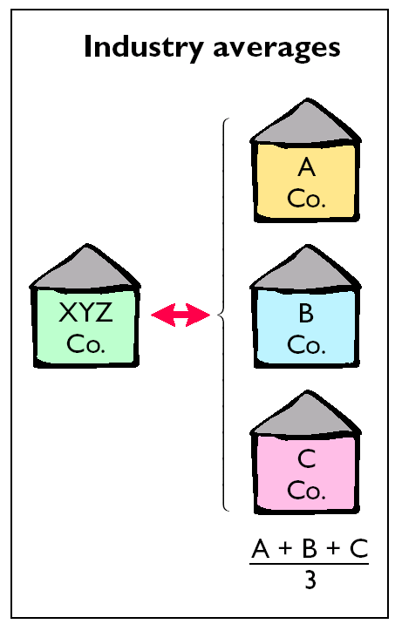
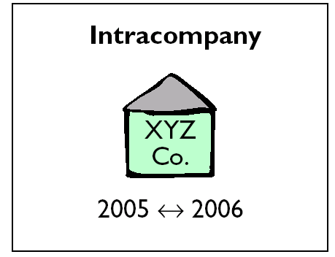
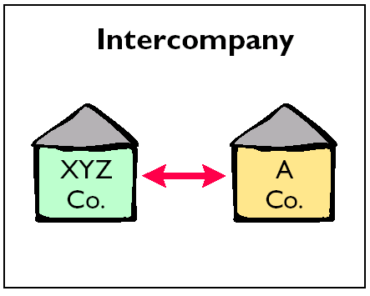
COMPARATIVE ANALYSIS

Slide 6
TOOLS OF FINANCIAL STATEMENT ANALYSIS
STUDY OBJECTIVE 2
Three commonly used tools are utilized to evaluate the significance of financial statement data.
1) Horizontal analysis (trend analysis) evaluates a series of financial statement data over a period of time.
2) Vertical analysis evaluates financial statement data expressing each item in a financial statement as a percent of a base amount.
3) Ratio analysis expresses the relationship among selected items of financial statement data.
Notes:
4

Slide 7
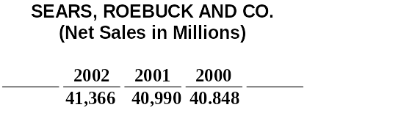
SEARS, ROEBUCK’S NET SALES
STUDY OBJECTIVE 3
The purpose of horizontal analysis is to determine the increase or decrease that has taken place. This change may be expressed as either an amount or a percentage. The recent net sales figures of Sears, Roebuck and Co. are shown above.
Notes:
5

Slide 8
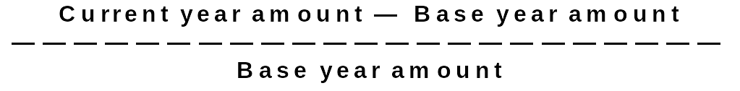
FORMULA FOR HORIZONTAL ANALYSIS OF CHANGES SINCE BASE PERIOD
Given that 2000 is the base year, we can measure all percentage increases or decreases from this base period amount as shown below.
Change since base period

Slide 9

FORMULA FOR HORIZONTAL ANALYSIS OF CURRENT YEAR
Alternatively, we can express current year sales as a percentage of the base period. This is done by dividing the current year amount by the base year amount, as shown below.
Current results in relation to base period

Slide 10
HORIZONTAL ANALYSIS OF A BALANCE SHEET
The two-year condensed balance sheet of Quality Department Store Inc. for 2002 and 2001 showing dollar and percentage changes is displayed in Illustration 19-5.
In the asset section, plant assets (net) increased $167,500 or 26.5%.
In the liabilities section, current liabilities increased $41,500 or 13.7%.
In the stockholders’ equity section, retained earnings increased $202,600 or 38.6%.
It appears the company expanded its asset base during 2002 and financed the expansion by retaining income in the firm.
Notes:
6

Slide 11
HORIZONTAL ANALYSIS OF
INCOME STATEMENTS
The two-year comparative income statements of Quality
Department Store Inc. for 2002 and 2001 is shown in
condensed form on Illustration 19-6. Horizontal analysis
of the comparative income statement shows the following
changes:
Net sales increased $260,000, or 14.2%
($260,000 ÷ $1,837,000).
2) Cost of goods sold increased $141,000, or 12.4% ($141,000 ÷ $1,140,000).
Total operating expenses increased $37,000, or 11.6%
($37,000 ÷ $320,000).
Notes:
7

Slide 12
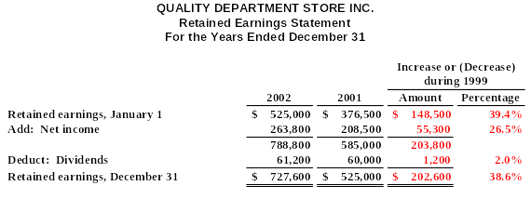
HORIZONTAL ANALYSIS OF
RETAINED EARNINGS STATEMENTS
Analyzed horizontally:
1) Net income increased $55,300, or 26.5%.
2) Common dividends increased only $1,200, or 2%.
3) Ending retained earnings increased 38.6%.

Slide 13
Review
In horizontal analysis, each item is expressed as a percentage of the:
net income amount.
stockholders’ equity amount.
total assets amount.
base year amount.

Slide 14
Review
In horizontal analysis, each item is expressed as a percentage of the:
net income amount.
stockholders’ equity amount.
total assets amount.
base year amount.

Slide 15
VERTICAL ANALYSIS OF BALANCE SHEETS
STUDY OBJECTIVE 4
Presented on the next slide is the two-year comparative balance sheet of Quality Department Store Inc. for 2002 and 2001.
1 Current assets increased $75,000 from 2001 to 2002, they decreased from 59.2% to 55.6% of total assets.
2 Plant assets (net) increased from 39.7% to 43.6% of total assets, and
3 Retained earnings increased from 32.9% to 39.7% of total liabilities and stockholders’ equity.
These results reinforce earlier observations that Quality is financing its growth through retention of earnings rather than from issuing additional debt.

Slide 16
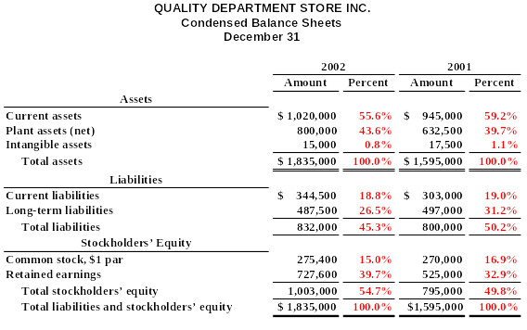
VERTICAL ANALYSIS OF BALANCE SHEETS

Slide 17
VERTICAL ANALYSIS OF INCOME STATEMENTS
Vertical analysis of the two-year comparative income statement of Quality Department Store Inc. for 2002 and 2001 is shown on the next slide.
1) Cost of goods sold as a percentage of net sales declined 1% (62.1% versus 61.1%).
2) Total operating expenses declined 0.4% (17.4% versus 17.0%).
3) Net income as a percent of net sales therefore increased from 11.4% to 12.6%.
Quality appears to be a profitable enterprise that is becoming more successful.
Notes:
9

Slide 18
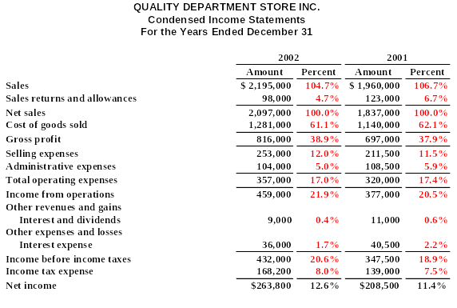
VERTICAL ANALYSIS OF INCOME STATEMENTS

Slide 19
INTERCOMPANY INCOME STATEMENT COMPARISON
Vertical analysis enables you to compare companies of different sizes. Quantity’s major competitor is a Sears, Roebuck store in a nearby town. Using vertical analysis, the small Quality Department Store Inc. can be meaningfully compared to the much larger Sears.
1 Gross profit rates were somewhat comparable at 38.9% and 38.0%.
2 Income from operations percentages were significantly different at 21.9% and 5.0%.
3 Quality’s selling and administrative expenses percentage was much lower than Sears’ (17% to 33%.)
4 Sears’ net income as a percentage of sales was much lower than Quality’s ( 3.3% to 12.6%.)
Notes:
17

Slide 20
Review
In vertical analysis, the base amount for depreciation expense is generally:
net sales.
depreciation expense in a previous year.
gross profit.
fixed assets.

Slide 21
Review
In vertical analysis, the base amount for depreciation expense is generally:
net sales.
depreciation expense in a previous year.
gross profit.
fixed assets.

Slide 22
RATIO ANALYSIS
STUDY OBJECTIVE 5
Ratio analysis expresses the relationship among selected items of financial statement data.
A ratio expresses the mathematical relationship between one quantity and another.
A single ratio by itself is not very meaningful, in the upcoming illustrations we will use:
1) Intracompany comparisons for two years for the Quality Department Store.
2) Industry average comparisons based on median ratios for department stores from Dun & Bradstreet and Robert Morris Associates’ median ratios.
3) Intercompany comparisons based on the Sears, Roebuck and Co., as Quality Department Store’s principal competitor.

Slide 23
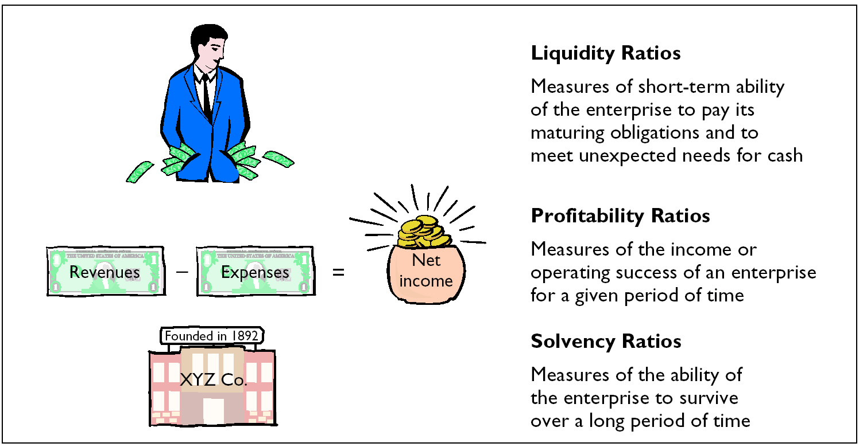
FINANCIAL RATIO CLASSIFICATIONS

Slide 24
CURRENT RATIO
The current ratio (working capital ratio) is a widely
used measure for evaluating a company’s liquidity
and short-term debt-paying ability.
It is computed by dividing current assets by current
liabilities and is a more dependable indicator of
liquidity than working capital.
The current ratios for Quality Department Store and
comparative data are shown below.
CURRENT ASSETS CURRENT RATIO = ——————————— CURRENT LIABILITIES

Slide 25


CURRENT RATIO
Quality Department Store
Notes:
27

Slide 26
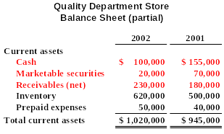
CURRENT ASSETS OF QUALITY DEPARTMENT STORE

Slide 27
ACID-TEST RATIO
The acid-test ratio (quick ratio) is a measure of
a company’s short-term liquidity.
It is computed by dividing the sum of cash,
marketable securities, and net receivables by
current liabilities.
The acid-test ratios for Quality Department
Store and comparative data are on the next
slide.
CASH + MARKETABLE SECURITIES + RECEIVABLES (NET) ACID-TEST RATIO = ———————————————————————————— CURRENT LIABILITIES

Slide 28


ACID-TEST RATIO
Quality Department Store

Slide 29
RECEIVABLES TURNOVER
The receivables turnover ratio is used to assess the liquidity of the receivables.
It measures the number of times, on average, receivables are collected during the period.
The ratio is computed by dividing net credit sales by average net receivables.
NET CREDIT SALES RECEIVABLES TURNOVER = ——————————————— AVERAGE NET RECEIVABLES

Slide 30
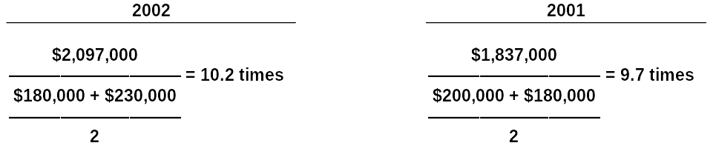

RECEIVABLES TURNOVER
Quality Department Store
[
]
[
]

Slide 31
INVENTORY TURNOVER
The inventory turnover ratio measures the number of times, on average, the inventory is sold during the period.
Its purpose is to measure the liquidity of the inventory. It is computed by dividing cost of goods sold by average inventory during the year.
COST OF GOODS SOLD INVENTORY TURNOVER = ———————————— AVERAGE INVENTORY

Slide 32
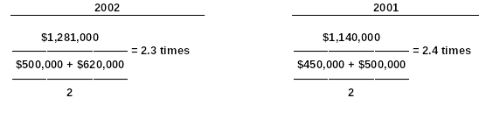

INVENTORY TURNOVER
Quality Department Store
[
]
[
]

Slide 33
PROFIT MARGIN
The profit margin ratio is a measure of the percentage of each dollar of sales that results in net income.
It is computed by dividing net income by net sales.
NET INCOME PROFIT MARGIN ON SALES = —————— NET SALES
Notes:
12

Slide 34


PROFIT MARGIN RATIO
Quality Department Store

Slide 35
ASSET TURNOVER
Asset turnover measures how efficiently a company uses its assets to generate sales.
It is determined by dividing net sales by average assets.
NET SALES ASSET TURNOVER = ————————— AVERAGE ASSETS

Slide 36
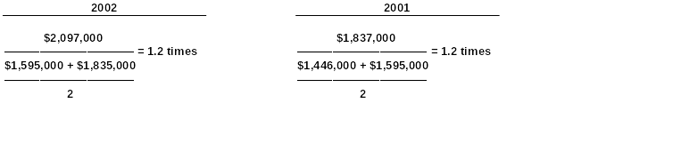

ASSET TURNOVER
Quality Department Store
[
]
[
]

Slide 37
RETURN ON ASSETS
An overall measure of profitability is return on assets. It is computed by dividing net income by average assets for the period.
NET INCOME RETURN ON ASSETS = ————————— AVERAGE ASSETS
Notes:
13

Slide 38
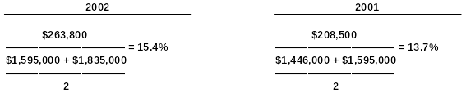
RETURN ON ASSETS
Quality Department Store
[
]
[
]
Industry average
Sears, Roebuck and Co.
————————
————————————
8.29%
3.13%

Slide 39
RETURN ON COMMON STOCKHOLDERS’ EQUITY
A ratio that measures profitability from the viewpoint of the common stockholder is return on common stockholders’ equity.
It is computed by dividing net income by average common stockholders’ equity.
RETURN ON COMMON NET INCOME STOCKHOLDERS’ EQUITY = ——————————————————————— AVERAGE COMMON STOCKHOLDERS’ EQUITY
Notes:
14

Slide 40
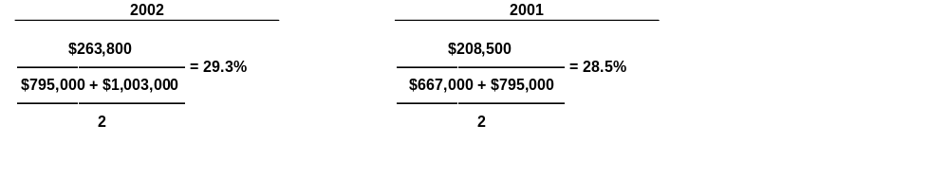

RETURN ON COMMON STOCKHOLDERS’ EQUITY
Quality Department Store
[
]
[
]

Slide 41
RETURN ON COMMON STOCKHOLDERS’ EQUITY WITH PREFERRED STOCK
When preferred stock is present, preferred dividend requirements are deducted from net income to compute income available to common stockholders.
The par value of preferred stock (or call price – if applicable) must be deducted from total stockholders’ equity to determine the amount of common stockholders’ equity used in this ratio. The ratio then appears as shown below.
RATE OF RETURN ON COMMON NET INCOME – PREFERRED DIVIDENDS STOCKHOLDERS’ EQUITY = ——————————————————————— AVERAGE COMMON STOCKHOLDERS’ EQUITY

Slide 42
EARNINGS PER SHARE
Earnings per share (EPS) is a measure of net income earned on each share of common stock.
It is calculated by dividing net income by the number of weighted average common shares outstanding during the year.
EARNINGS NET INCOME PER SHARE = ———————————————————————————— WEIGHTED AVERAGE COMMON SHARES OUTSTANDING
Notes:
15

Slide 43
EARNINGS PER SHARE
Quality Department Store
2002
2001
$263,000
$208,500
[
————————— = $.96
————— = $.77
]
270,000 + 275,400
270,000
—————————
2
Notes:
33

Slide 44
PRICE-EARNINGS RATIO
The price-earnings (PE) ratio measures the ratio of the market price of each share of common stock to the earnings per share.
It is computed by dividing the market price per share of common stock by earnings per share.
MARKET PRICE PER SHARE OF COMMON STOCK PRICE-EARNINGS RATIO = ————————————————————————— EARNINGS PER SHARE

Slide 45
PRICE-EARNINGS RATIO
Quality Department Store
2002
2001
$12.00
$ 8.00
——— = 12.5 times
——— = 10.4 times
$ .96
$ .77
Industry average
Sears, Roebuck and Co.
————————
———————————
26 times
7 times

Slide 46
PAYOUT RATIO
The payout ratio measures the percentage of earnings distributed in the form of cash dividends. It is computed by dividing cash dividends by net income.
CASH DIVIDENDS PAYOUT RATIO = ————————— NET INCOME

Slide 47

PAYOUT RATIO
Quality Department Store
Industry average
Sears, Roebuck and Co.
————————
———————————
16.0%
20%

Slide 48
DEBT TO TOTAL ASSETS
The debt to total assets ratio measures the percentage of total assets provided by creditors.
It is computed by dividing total debt by total assets.
TOTAL DEBT DEBT TO TOTAL ASSETS = ———————— TOTAL ASSETS

Slide 49
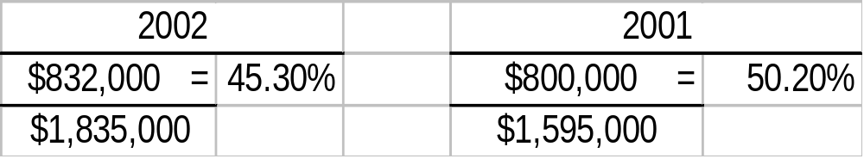
DEBT TO TOTAL ASSETS RATIO
Quality Department Store
Industry average
Sears, Roebuck and Co.
————————
————————————
40.1%
76.1%

Slide 50
TIMES INTEREST EARNED
Times interest earned provides an indication of the company’s ability to meet interest payments as they come due. It is computed by dividing income before income taxes and interest expense by interest expense.
TIMES INTEREST INCOME BEFORE INCOME TAXES AND INTEREST EXPENSE EARNED = ————————————————————————————— INTEREST EXPENSE

Slide 51

TIMES INTEREST EARNED
Quality Department Store
2002
2001
$468,000
$388,000
———— = 13 times
———— = 9.6 times
$36,000
$40,500

Slide 52
IRREGULAR OPERATIONS
STUDY OBJECTIVE 6
Three types of “Irregular” items:
1) Discontinued operations
2) Extraordinary items
3) Changes in accounting principle

Slide 53
DISCONTINUED OPERATIONS
The disposal of a significant segment of the business.
  The income or (loss) form discontinued operations consists of two parts:
    The income or (loss) form operations and
    The gain or ( loss) on the disposal of the segment
    The results are shown “net of tax”.

Slide 54
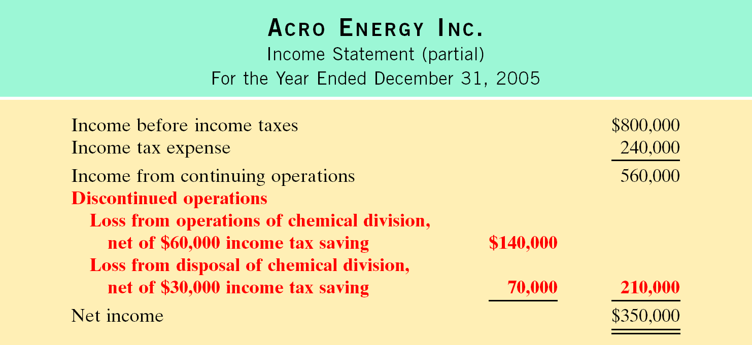
STATEMENT PRESENTATION OF DISCONTINUED OPERATIONS

Slide 55
EXTRAORDINARY ITEMS
Extraordinary items are events and transactions that meet two conditions:
  unusual in nature and
  infrequent in occurance
  The results are shown “net of tax”.

Slide 56
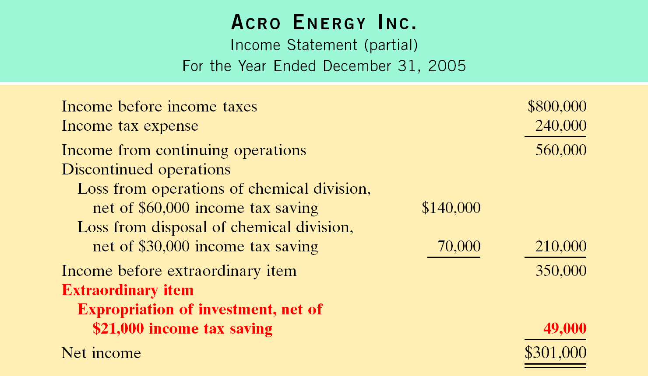
STATEMENT PRESENTATION OF EXTRAORDINARY ITEMS

Slide 57
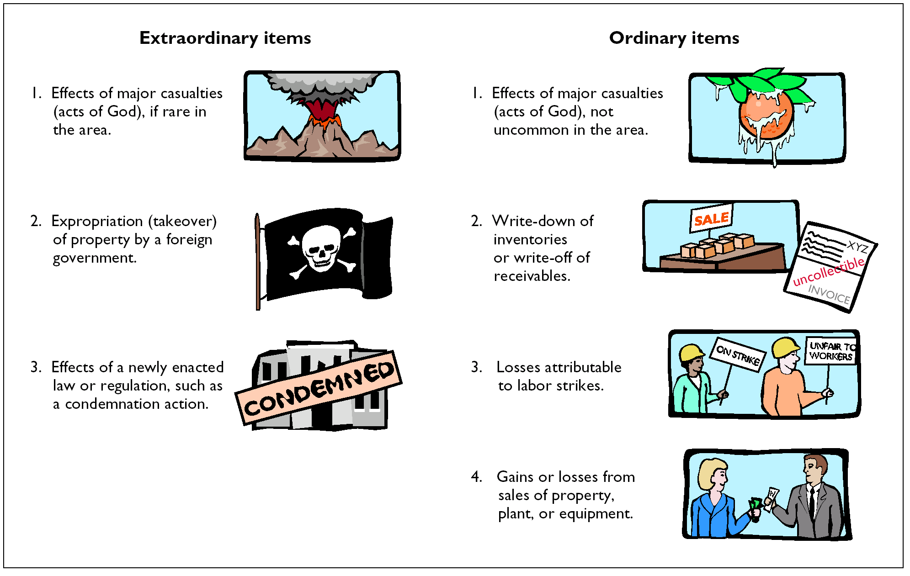
EXAMPLES OF EXTRAORDINARY AND ORDINARY ITEMS

Slide 58
CHANGE IN ACCOUNTING PRINCIPLE
A change in accounting principle occurs when the principle used in the current year is different form the one used the preceding year. When this occurs:
  The new principle is used to report the results of operations for the current year.
  The cumulative effect of the change on all prior year income statements should be disclosed “net of tax”.

Slide 59
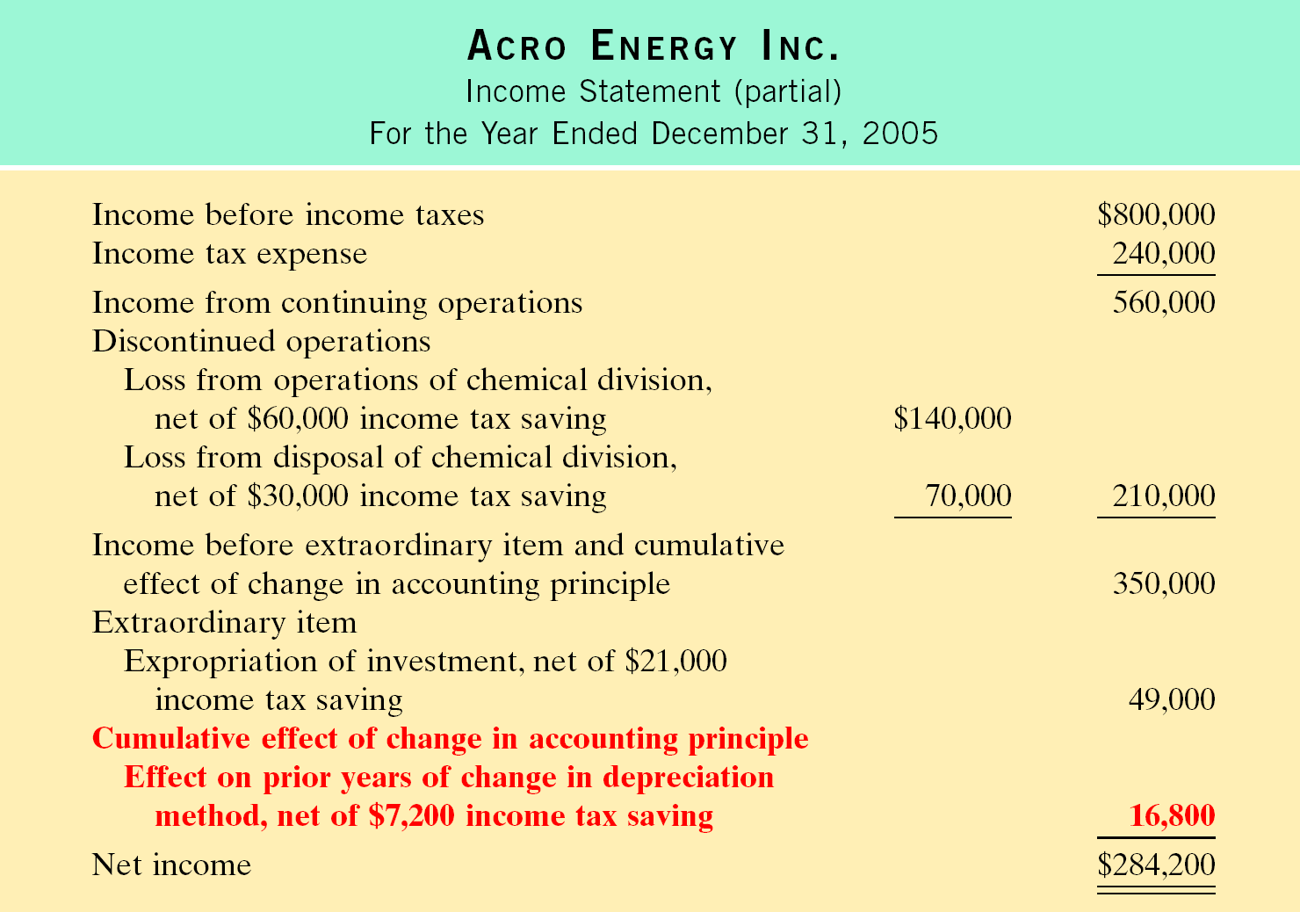
STATEMENT PRESENTATION OF CHANGE IN ACCOUNTING PRINCIPLE

Slide 60
LIMITATIONS OF FINANCIAL ANALYSIS
STUDY OBJECTIVE 7
You should be aware of some of the limitations of the three analytical tools illustrated in the chapter and of the financial statements on which they are based.
1) Estimates: Financial statements contain numerous estimates; to the extent that these estimates are inaccurate, the financial ratios and percentages are inaccurate.
2) Cost: Traditional financial statements are based on cost and are not adjusted for price-level changes. Comparisons of unadjusted financial data from different periods may be rendered invalid by significant inflation or deflation.

Slide 61
LIMITATIONS OF FINANCIAL ANALYSIS
3) Alternative Accounting Methods: Variations among companies in the application of GAAP may hamper comparability.
Differences in accounting methods might be detectable from reading the notes to the financial statements, adjusting the financial data to compensate for the different methods is difficult, if not impossible, in some cases.

Slide 62
LIMITATIONS OF FINANCIAL ANALYSIS
4) Atypical Data: Fiscal year-end data may not be typical of the financial condition during the year. Firms often establish a fiscal year-end that coincides with the low point in operating activity or in inventory levels. Thus, certain account balances may not be representative of the account balances during the year.
5) Diversification of Firms: Diversification in U.S. industries also restricts the usefulness of financial analysis. Many firms today are too diversified to be classified by industry, while others appear to be comparable when they are not.

Slide 63
Review
Which of the following is generally not considered to be a limitation of financial analysis?
Use of estimates.
Use of ratio analysis.
Use of cost.
Use of alternative accounting methods.

Slide 64
Review
Which of the following is generally not considered to be a limitation of financial analysis?
Use of estimates.
Use of ratio analysis.
Use of cost.
Use of alternative accounting methods.

Slide 65

COPYRIGHT
Copyright © 2005 John Wiley & Sons, Inc. All rights reserved. Reproduction or translation of this work beyond that permitted in Section 117 of the 1976 United States Copyright Act without the express written consent of the copyright owner is unlawful. Request for further information should be addressed to the Permissions Department, John Wiley & Sons, Inc. The purchaser may make back-up copies for his/her own use only and not for distribution or resale. The Publisher assumes no responsibility for errors, omissions, or damages, caused by the use of these programs or from the use of the information contained herein.

